Slide 1
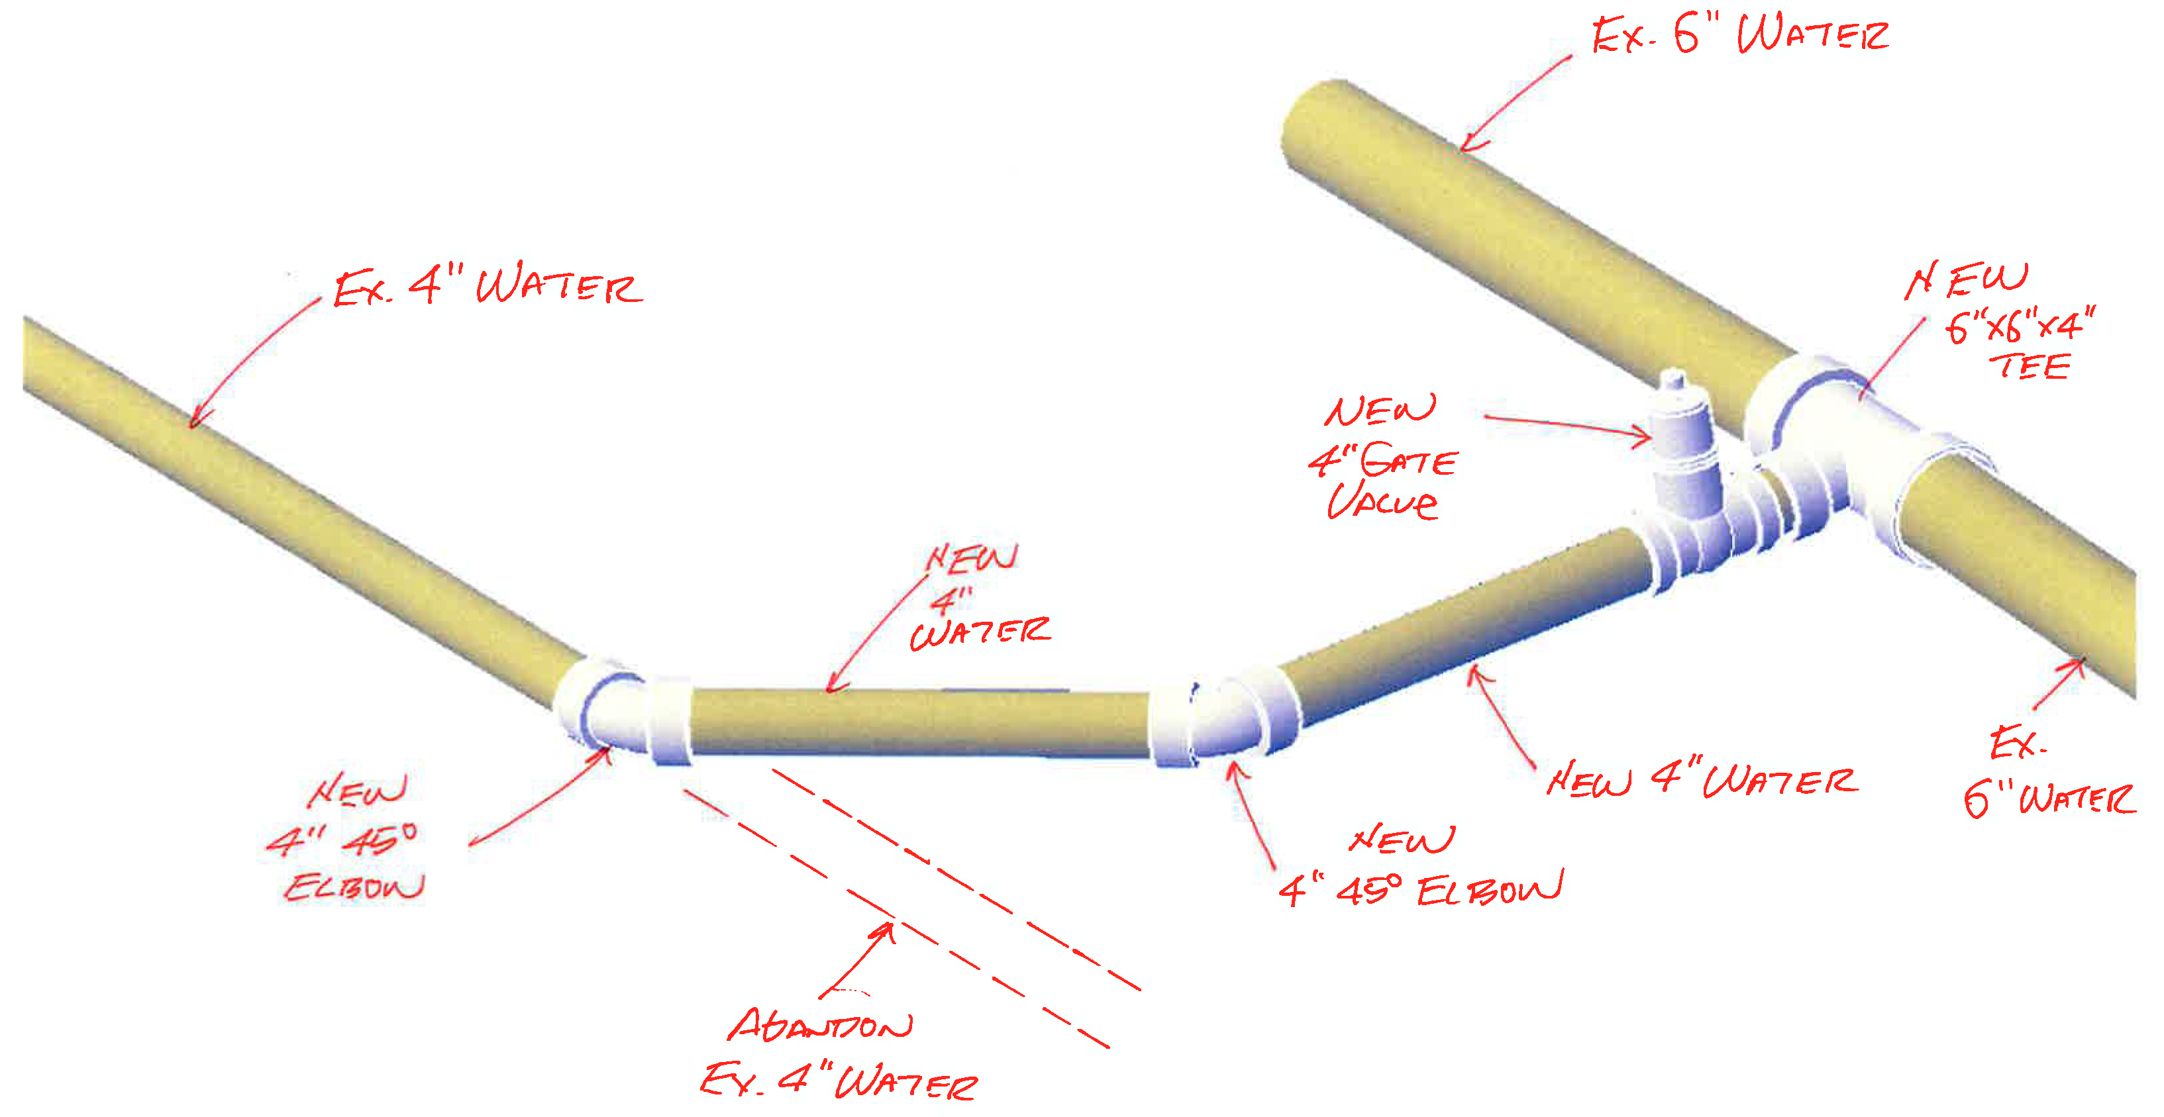
Utilities Department July 2021
Neighborhood
Water Main Rehab

Slide 2
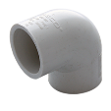
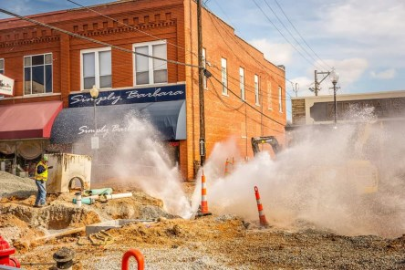
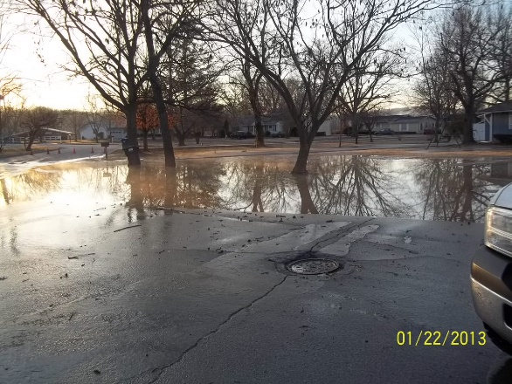
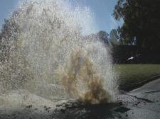
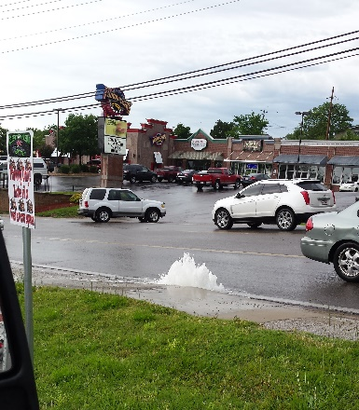
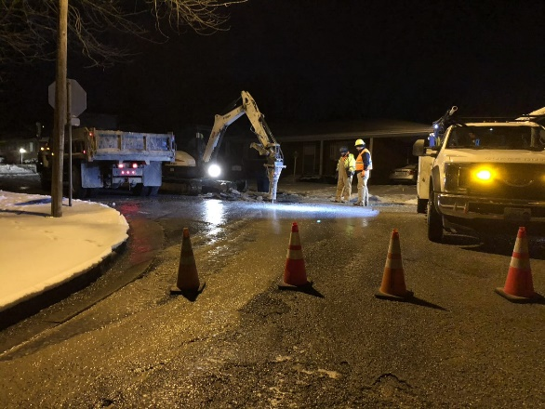
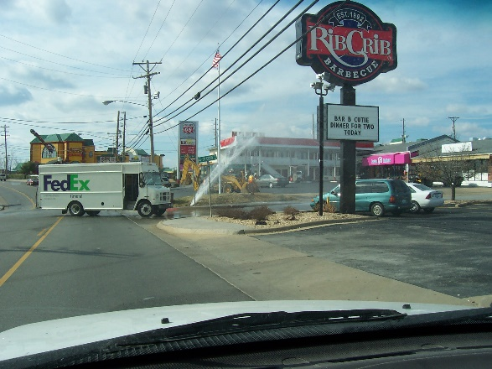
Causes of Water Leaks and Breaks
Natural Leaks/Breaks
Artificial Leaks/Breaks
Ground Contraction
Expansion due to temperature change
Life Cycle of Pipe Materials
Dig ups by contractors, homeowners, and other utility companies.
Much of the City’s neighborhood underground infrastructure was constructed more than 45 years ago; with an average lifespan of 50 years.
Notes:
A combination of material lifespan and installation practices at the time are key natural causes.
Effects of water main breaks:
Interruption of service
Loss of water
Introduction of air to the system
Movement of debris within the system
Damage to public right-of-way and potential damage to private property

Slide 3


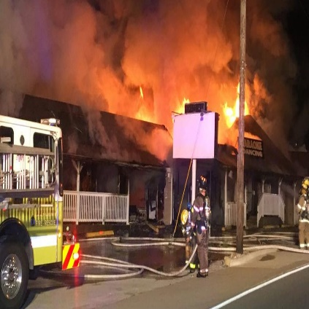
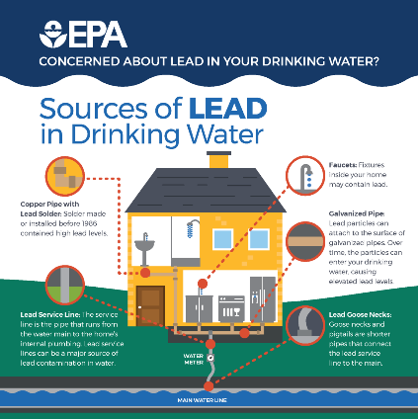
Neighborhood Rehab Goals
Improve Water Service
Reduce Water Service Interruptions
Improve Operations and Maintenance Abilities
Fire Protection
Improve Water Volume by Upsizing of Water Mains
Increase Number of Fire Hydrants to Meet Standards
Potential Increase of ISO Rating
Compliance with Updated Lead/Copper Rule
Inventory of Water Service Pipe Types
Reduction of Lead, Galvanized, and Copper Services
Notes:
Improve Water Service:
Provides an appropriate number of valves for maintenance such as fire hydrant valves.
Reduces dead-end lines by providing looping mains – reduces the need to flush hydrants to improve water quality of dead-end areas.
*With the additional valves and fire hydrants comes additional staff time to inspect and maintain. (Valves once every 10 years (currently at 6%) Fire hydrants annually (currently at 23%)
ISO – Company called “Insurance Services Office” creates ratings for fire departments and their surrounding communities. These ratings calculate how well-equipped fire departments are to put out fires in that community. Potentially better homeowner insurance rates.
Lead/Copper Rule:
Three years from effective date to build up capacity to be in compliance. (Funding source, action plan, building service line inventory)
Includes galvanized piping.
Public notifications if they have lead/copper/galvanized piping.
We are responsible for having private service lines changed out as well but not responsible for cost.
Provide filters for six months after lead service lines are replaced.

Slide 4
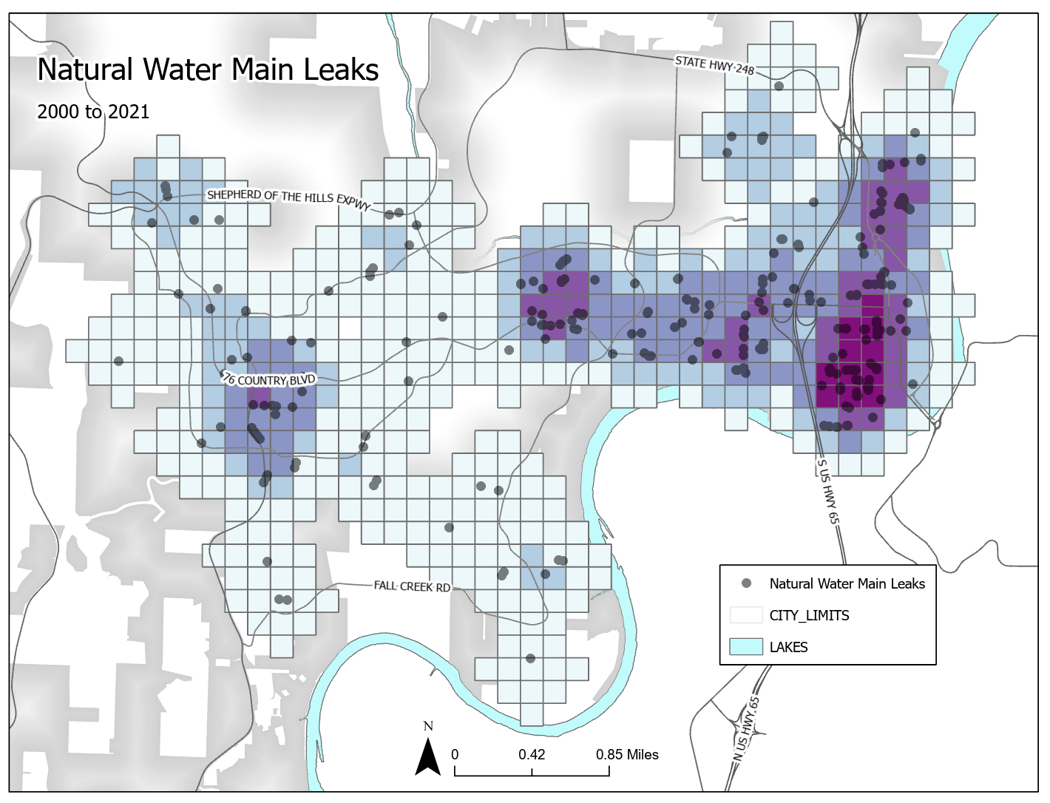
Branson Water Main Leaks & Breaks 2010 through April 2021
203 - City Wide Mains
165 - Neighborhood Mains (81%)
307 - City Wide Service Leaks
216 - Neighborhood Service Leaks (70%)
2010 to 2021
Notes:
Density exhibit showing areas of concentration.
Of the 203 main leaks 165 were located within neighborhoods.
Of the 307 service line leaks 216 were located within neighborhoods.
Approximately 55 artificial leaks in the last ten years.

Slide 5
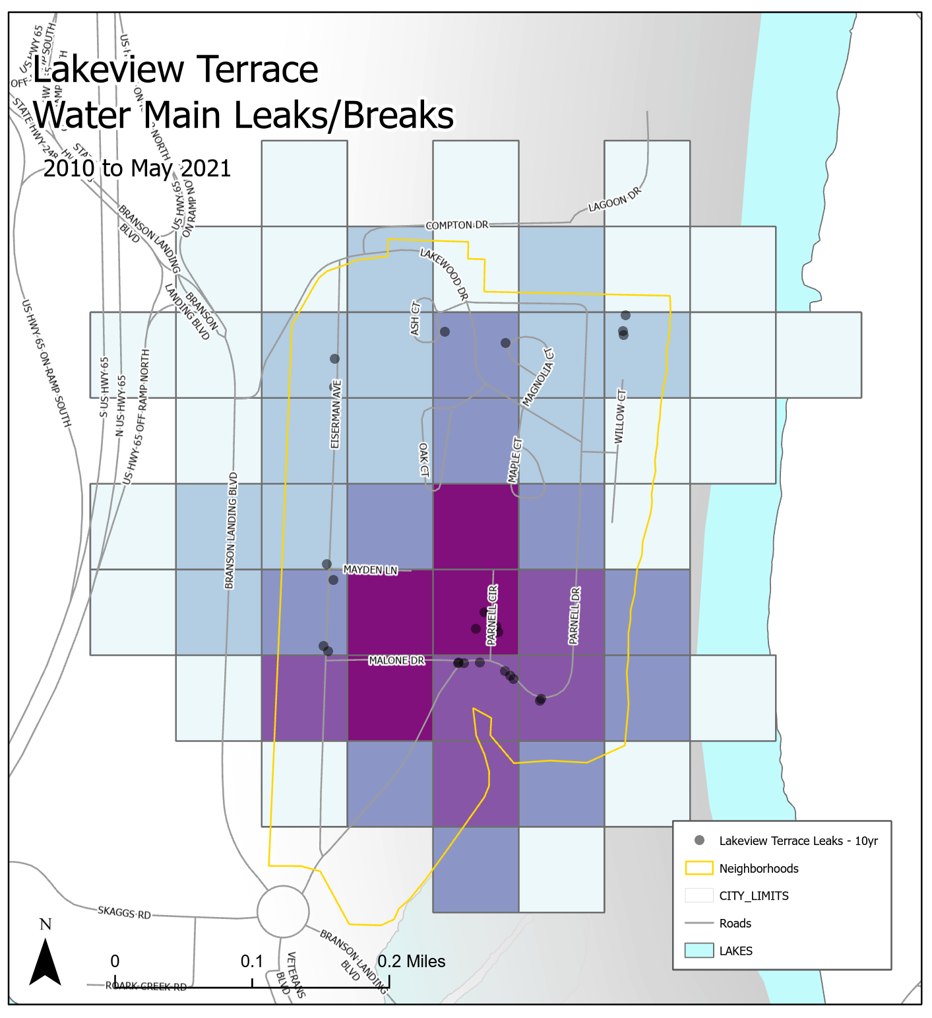
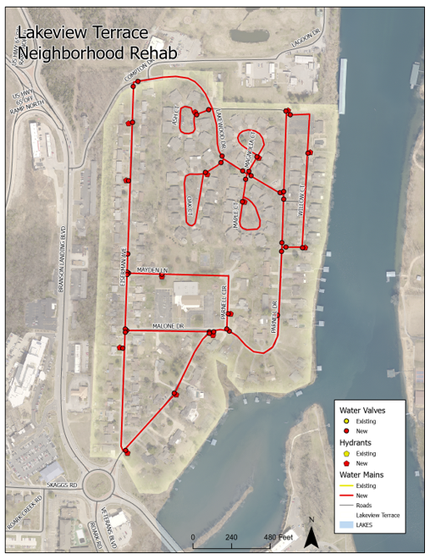
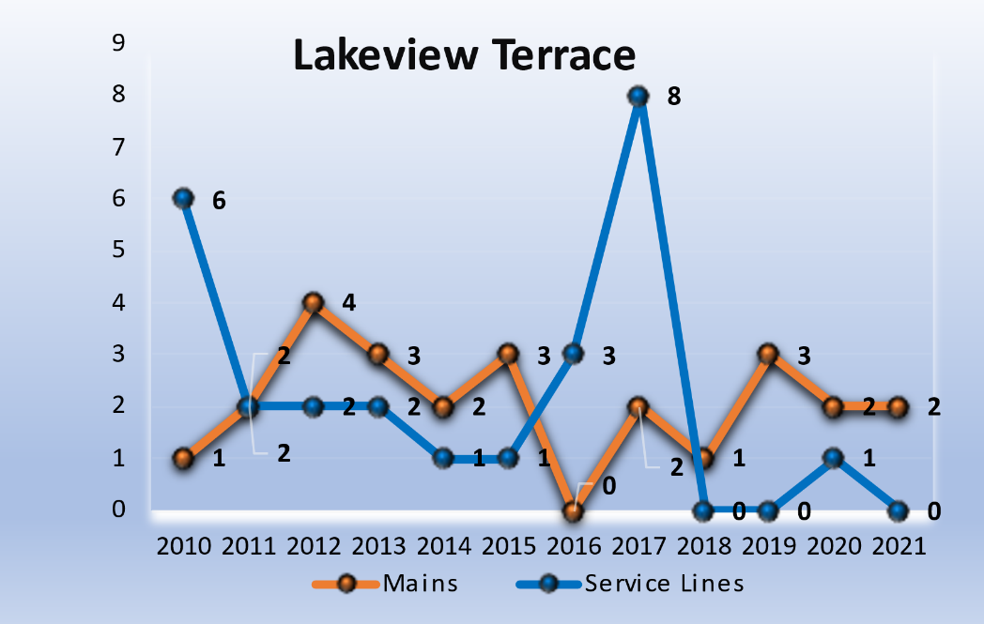
#1 - Lakeview Terrace
2010 to 2021
25 Water Main Leaks/Breaks
Main Sizes: 2-Inch, 4-inch, 6-inch
Material: Thin-walled PVC & Transite Pipe
30 Service Line Leaks
Current Length of Water Main:
2.45 Miles
Proposed Water Main Rehab Length:
2.26 Miles
Projected Cost:
Water Main: $3.6 Million
Notes:
Total Street Replacement Cost - $620,822
Storm Water Projects - $1,078,899
Private Sewer Services - $158,000

Slide 6
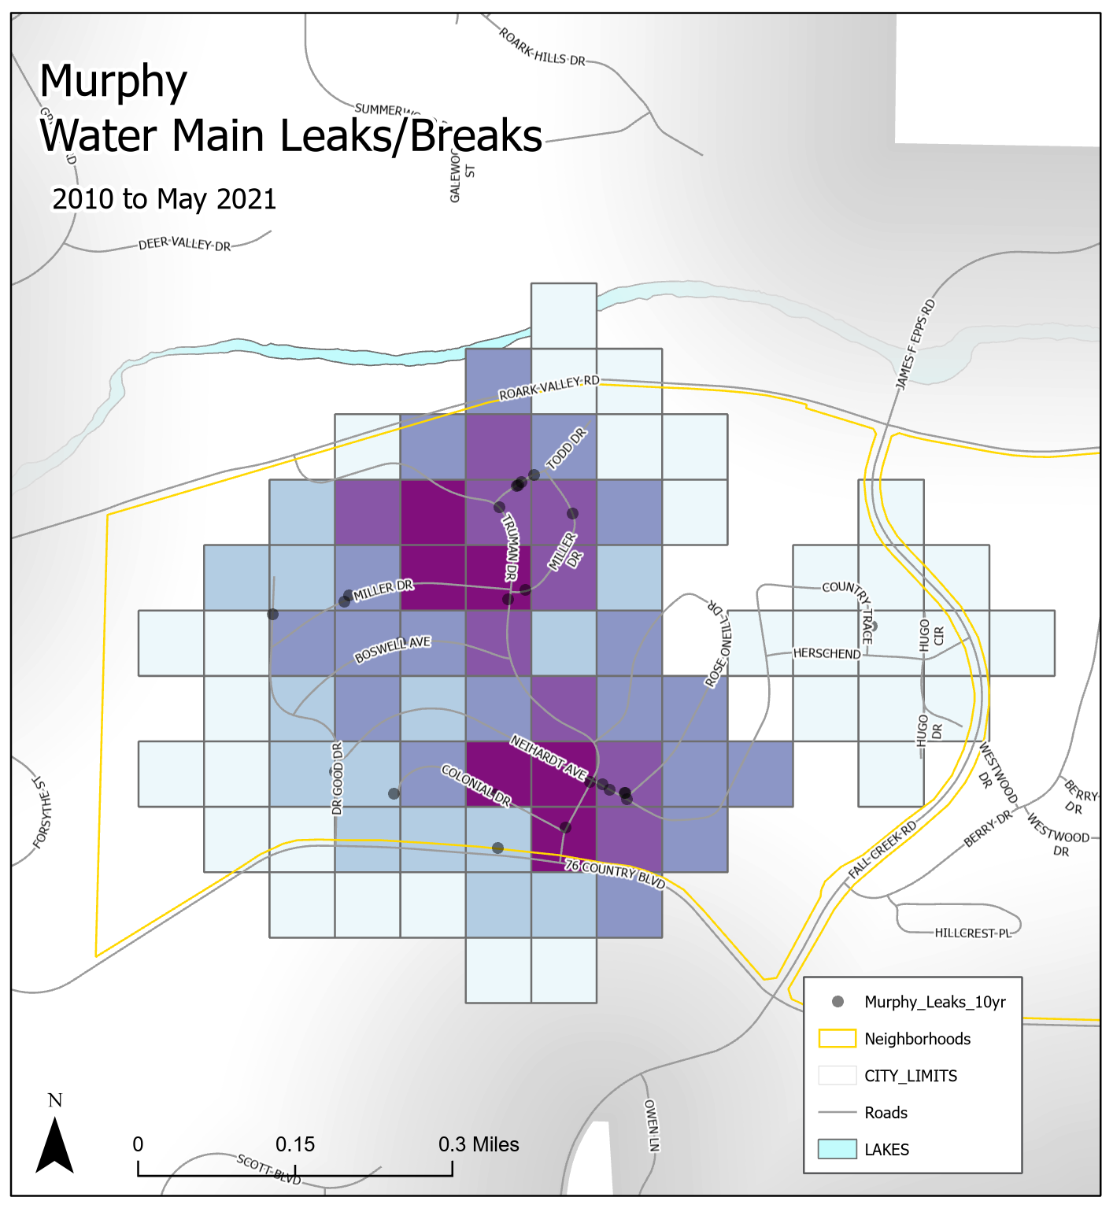
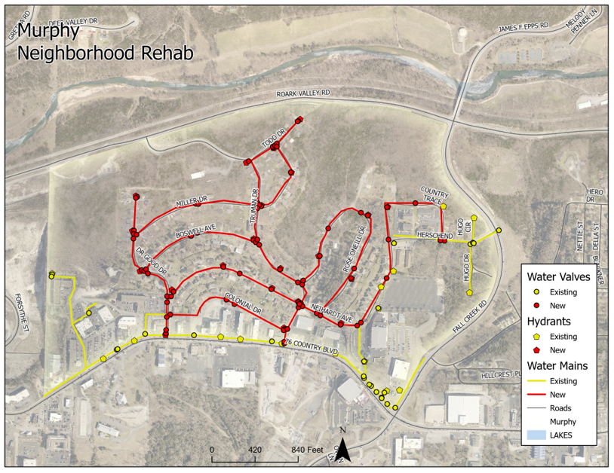
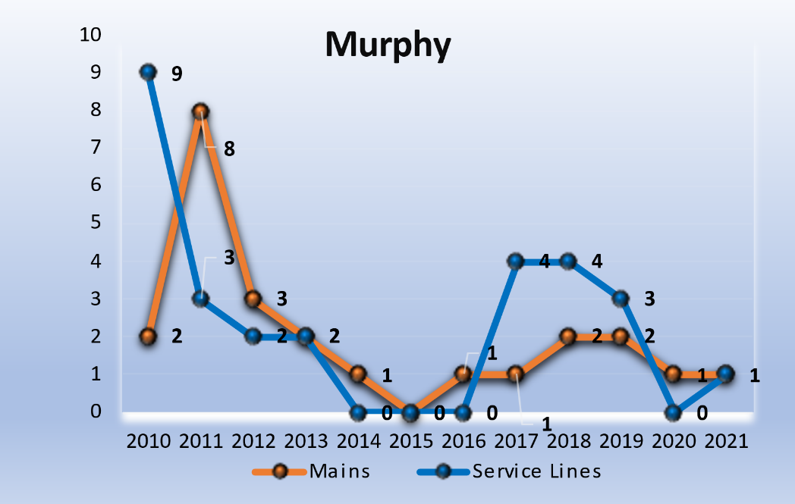
#2 – Murphy Addition
2010 to 2021
25 Water Main Leaks/Breaks
Main Sizes: 4-inch
Material: Thin-walled PVC & Transite Pipe
32 Service Line Leaks
Current Length of Water Main:
4.50 Miles
Proposed Water Main Rehab Length:
2.93 Miles
Projected Cost:
Water Main: $4.7 Million
Notes:
Total Street Replacement Cost - $802,220
Storm Water Project - $769,300

Slide 7
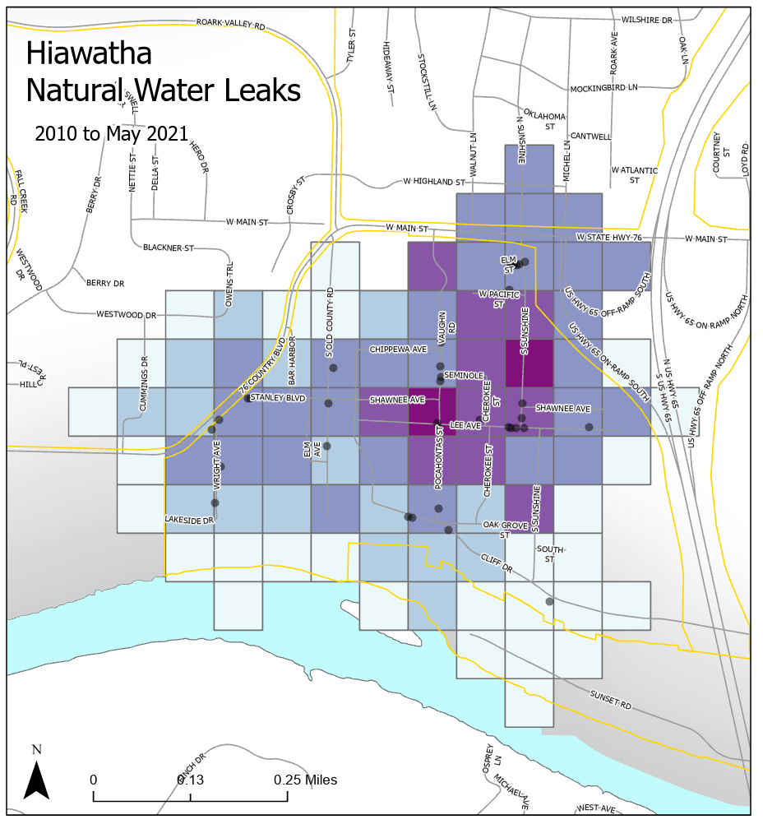
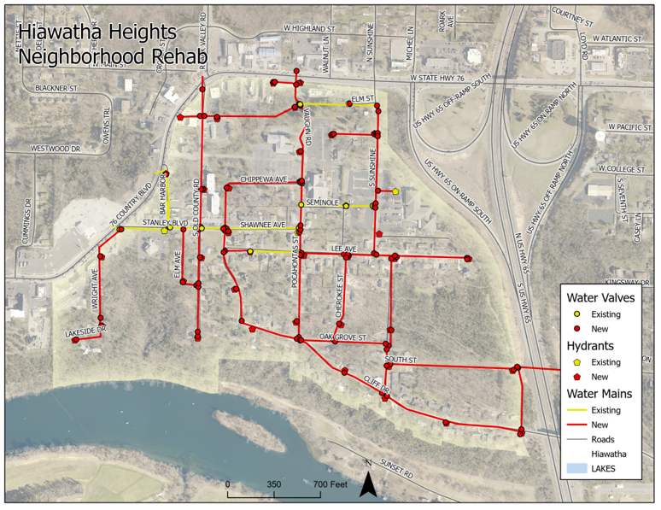
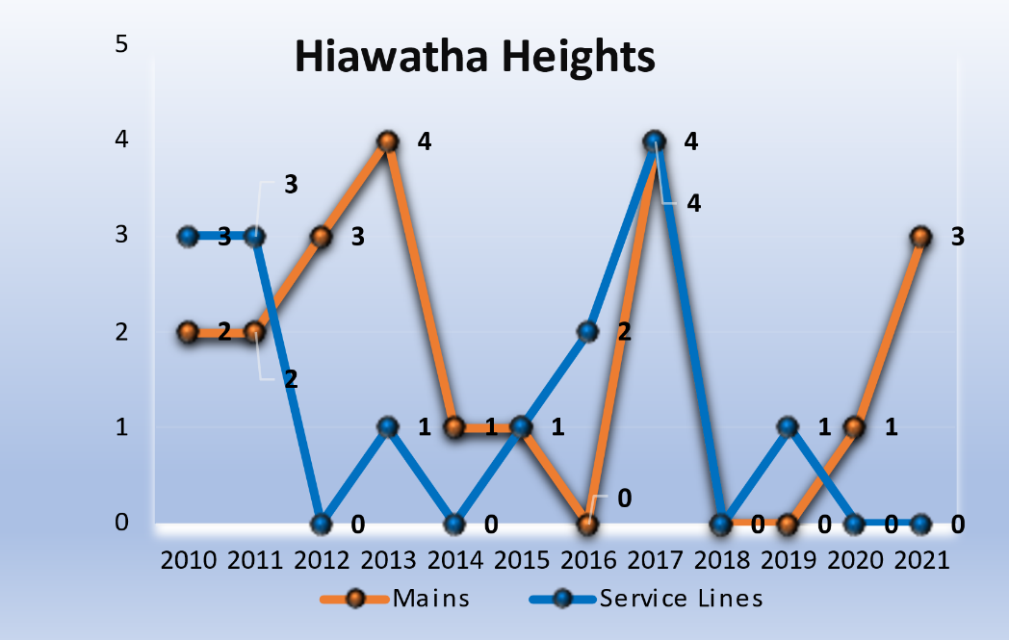
#3 – Hiawatha Heights
2010 to 2021
21 Water Main Leaks/Breaks
Main Sizes: 4-inch
Material: Thin-walled PVC & Transite Pipe
15 Service Line Leaks
Current Length of Water Main:
4.10 Miles
Proposed Water Main Rehab Length:
3.54 Miles
Projected Cost:
Water Main: $5.6 Million
Notes:
Total Street Replacement Cost - $835,616
Storm Water Project – Unknown at this time

Slide 8
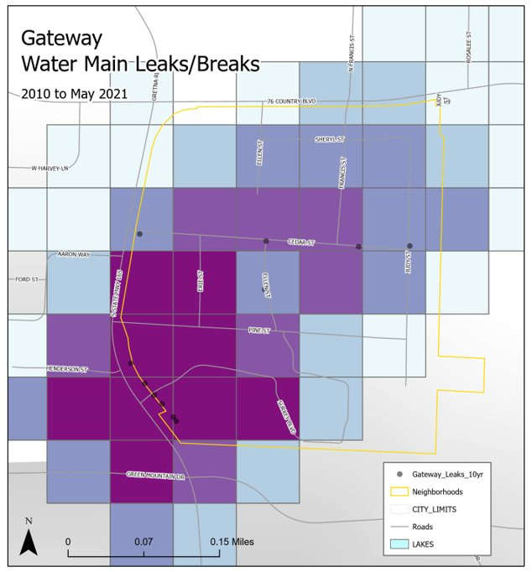
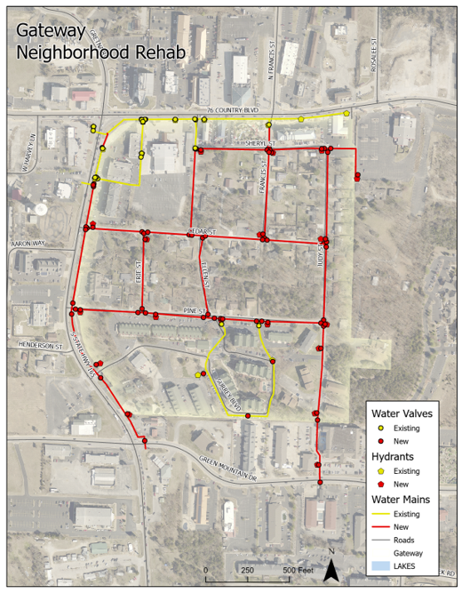
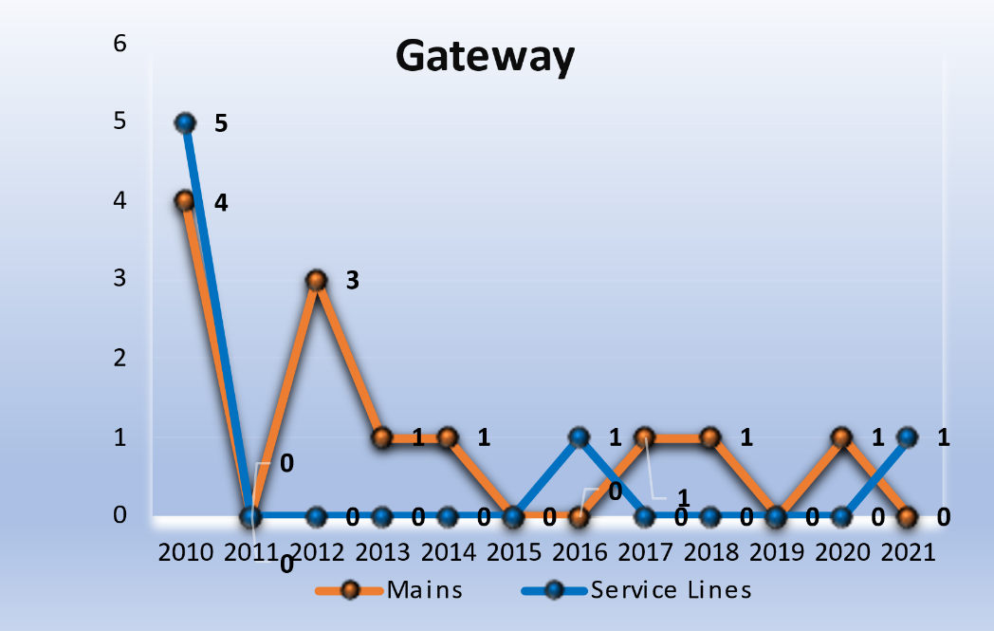
#4 - Gateway
2010 to 2021
12 Water Main Leaks/Breaks
Main Sizes: 4-inch, 6-inch
Material: Thin-walled PVC & Transite Pipe
7 Service Line Leaks
Current Length of Water Main:
2.75 Miles
Proposed Water Main Rehab Length:
1.92 Miles
Projected Cost:
Water Main: $3.1 Million
Notes:
Total Street Replacement Cost - $378,100
Storm Water Project – Unknown at this time

Slide 9
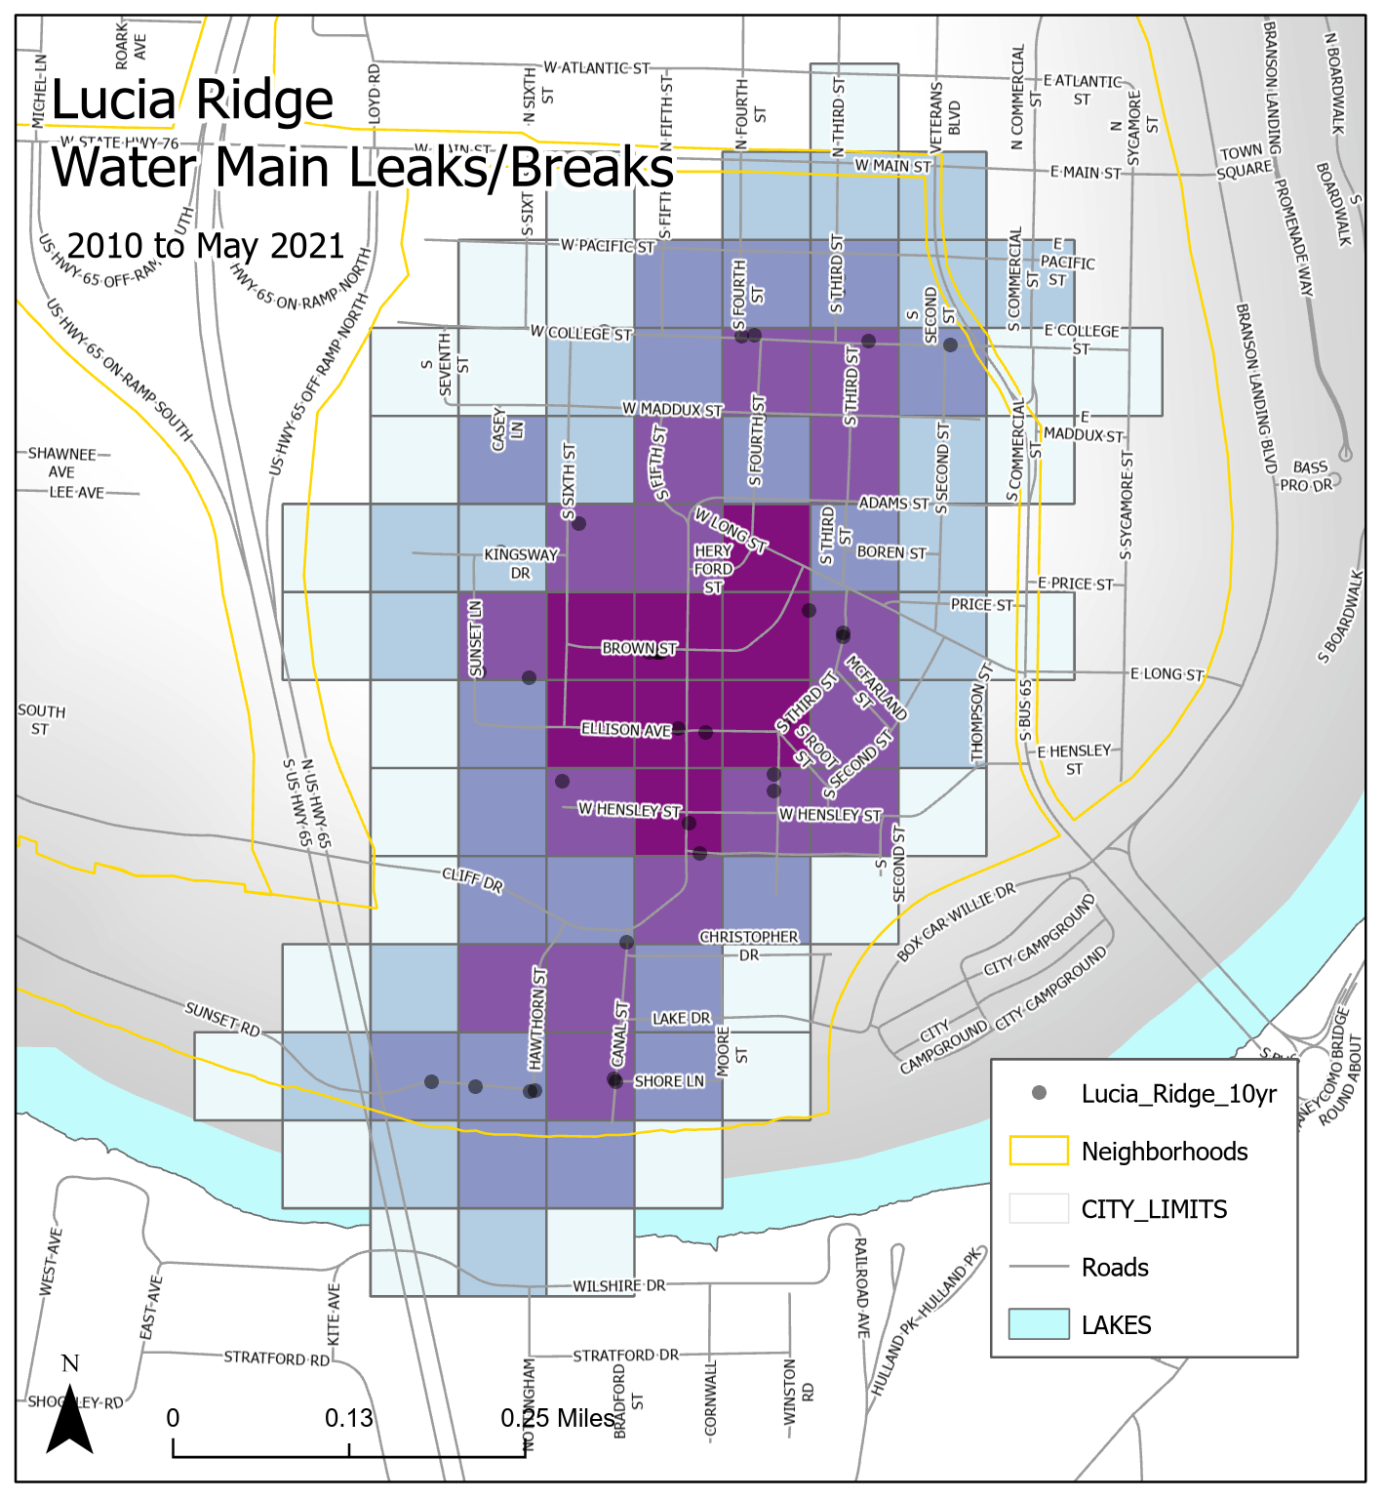
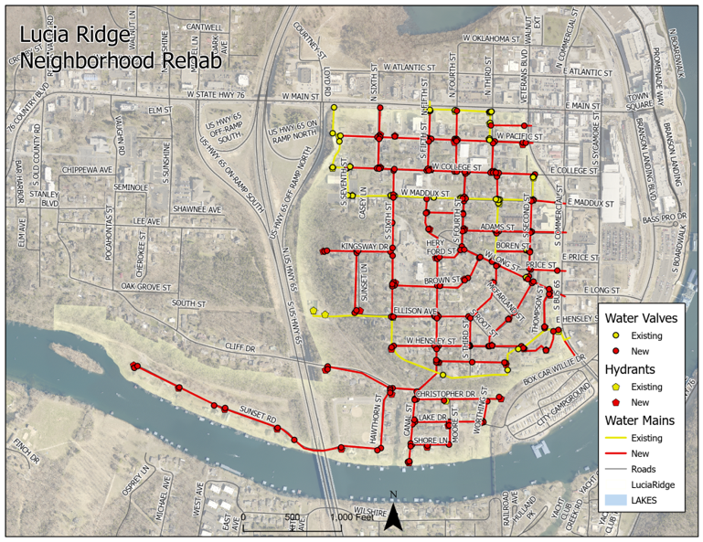
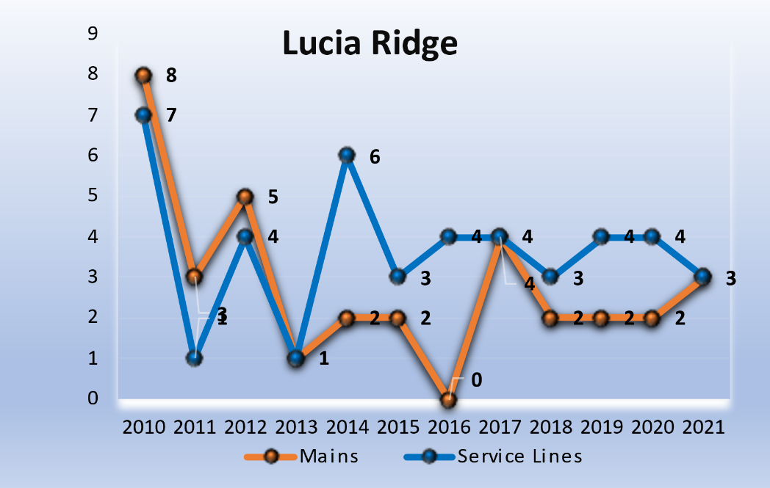
#5 – Lucia Ridge
2010 to 2021
34 Water Main Leaks/Breaks
Main Sizes: ¾”-inch, 1-inch, 2- Inch, 4-inch, 6-inch
Material: Thin-walled PVC & Transite Pipe
55 Service Line Leaks
Current Length of Water Main:
8.03 Miles
Proposed Water Main Rehab Length:
6.00 Miles
Projected Cost:
Water Main: $9.5 Million
Notes:
Total Street Replacement Cost - $1,654,371
Storm Water Project - $225,800
Private Sewer Services - $345,000

Slide 10
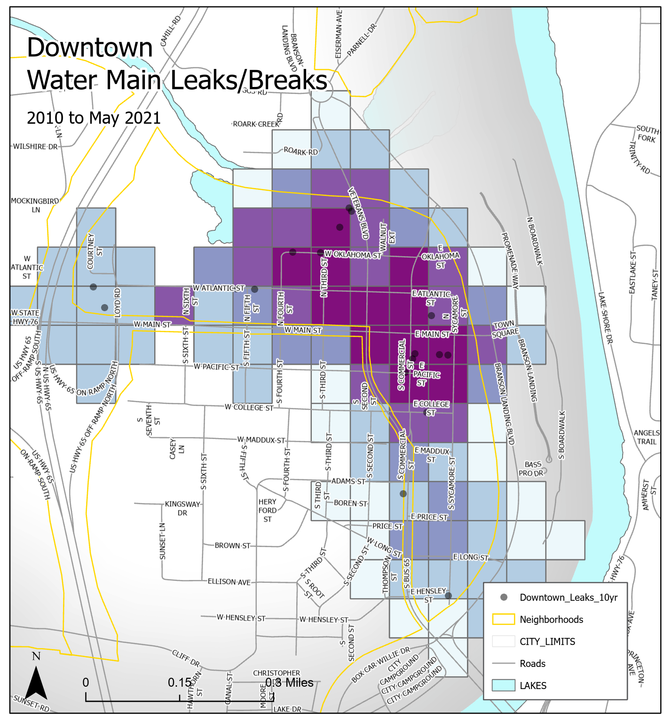
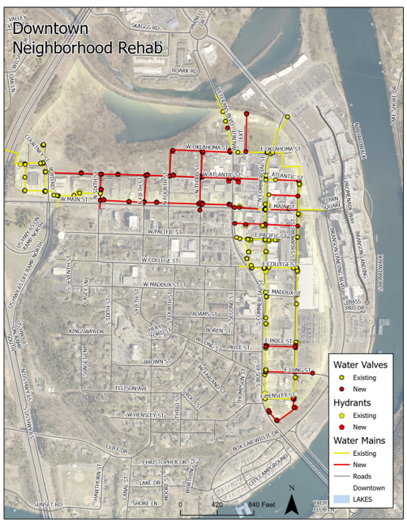
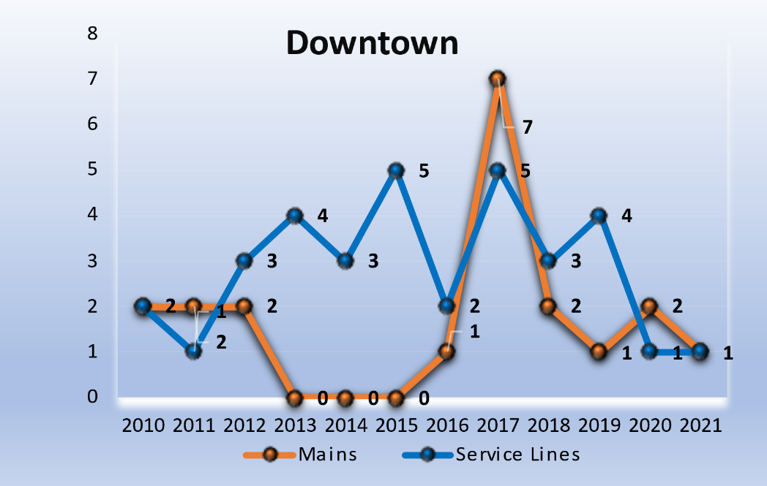
#6 - Downtown
2010 to 2021
20 Water Main Leaks/Breaks
Main Sizes: ¾”-inch, 1-inch, 2- Inch, 4-inch, 6-inch
Material: Thin-walled PVC & Transite Pipe
43 Service Line Leaks
Current Length of Water Main:
4.80 Miles
Proposed Water Main Rehab Length:
2.00 Miles
Projected Cost:
Water Main: $3.2 Million
Notes:
Total Street Replacement Cost - $389,595
Storm Water Project – Unknown at this time
Private Service Lines - $120,000

Slide 11
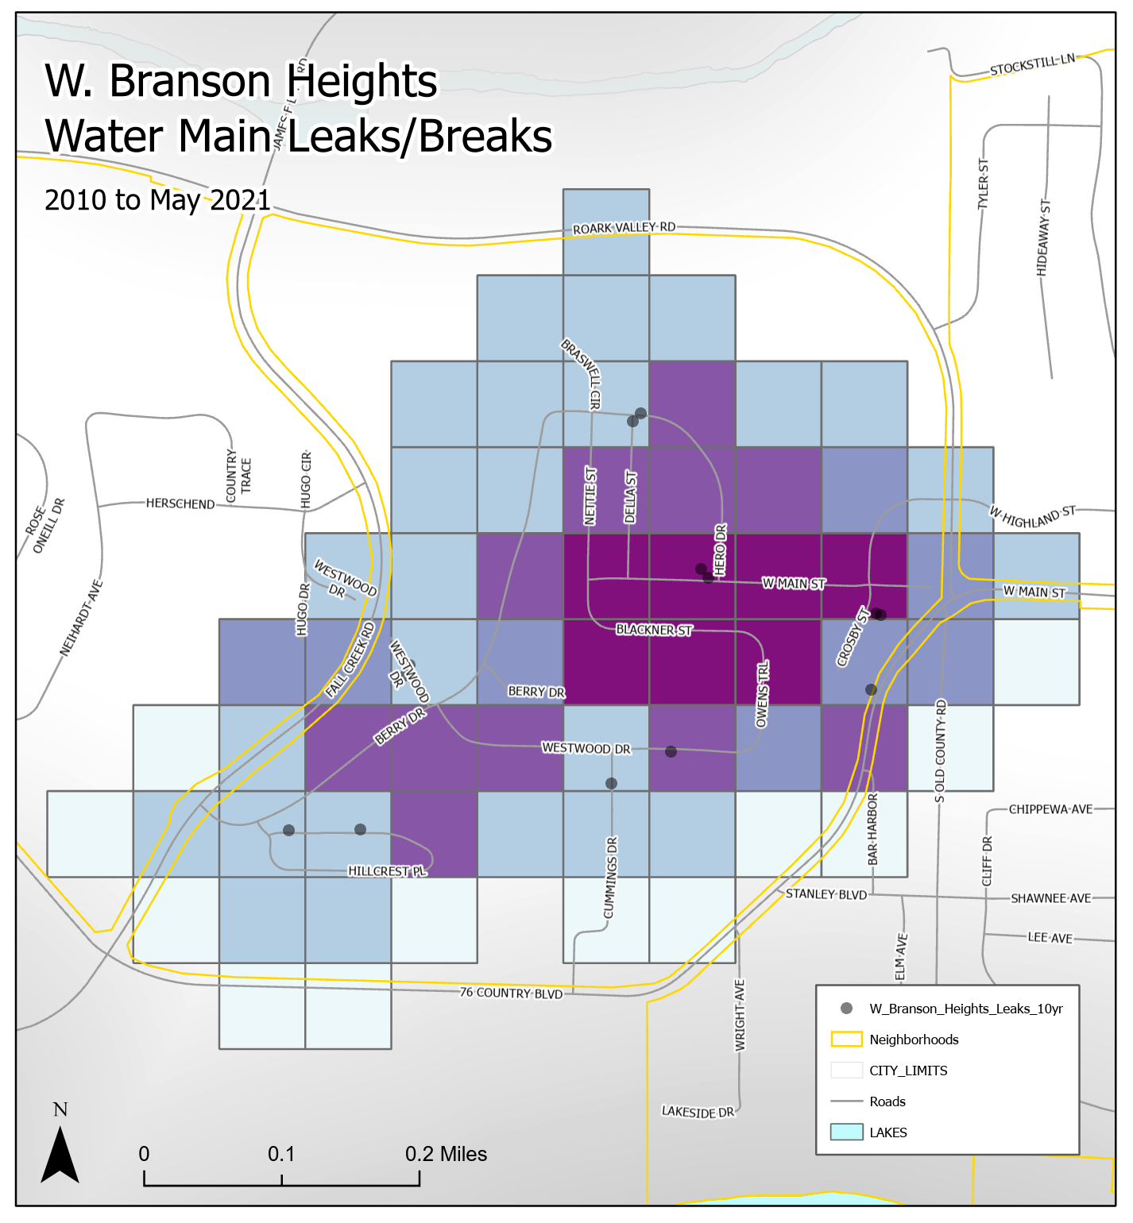
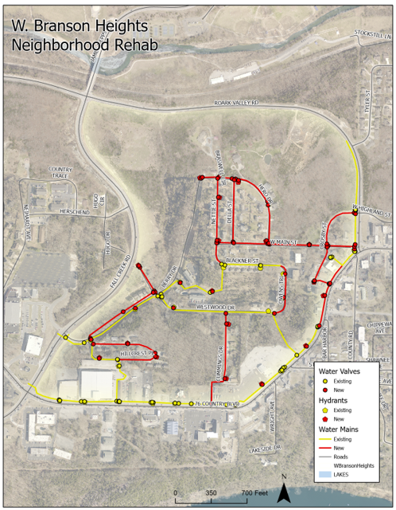
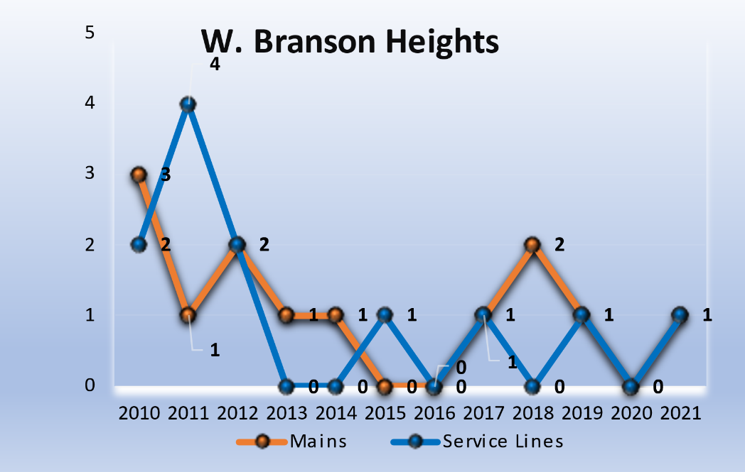
#7 – W. Branson Heights
2010 to 2021
13 Water Main Leaks/Breaks
Main Sizes: 4-inch, 6-inch
Material: Thin-walled PVC & Transite Pipe
12 Service Line Leaks
Current Length of Water Main:
3.61 Miles
Proposed Water Main Rehab Length:
1.90 Miles
Projected Cost:
Water Main: $3.0 Million
Notes:
Total Street Replacement Cost - $409,847
Storm Water Project – Unknown at this time

Slide 12
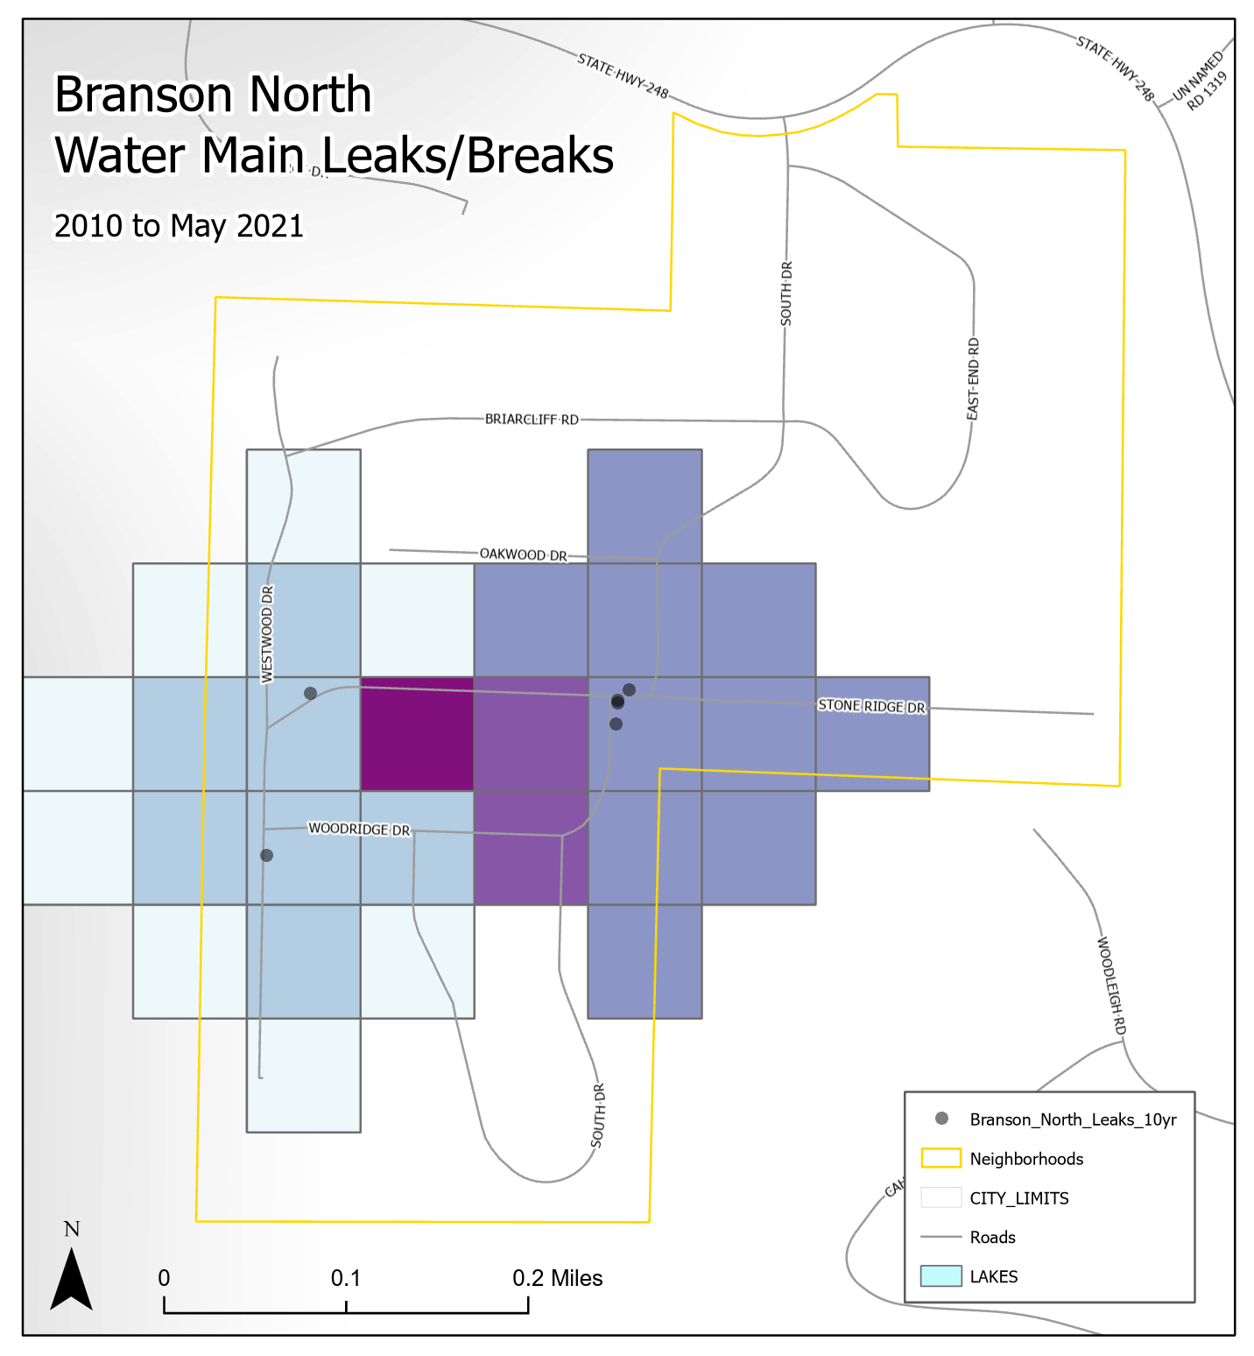
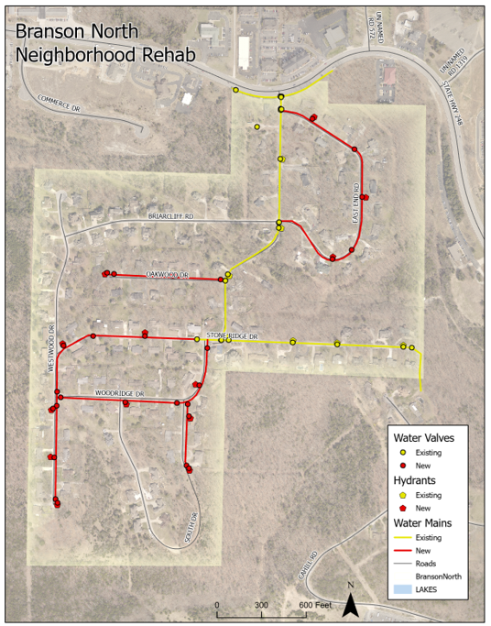
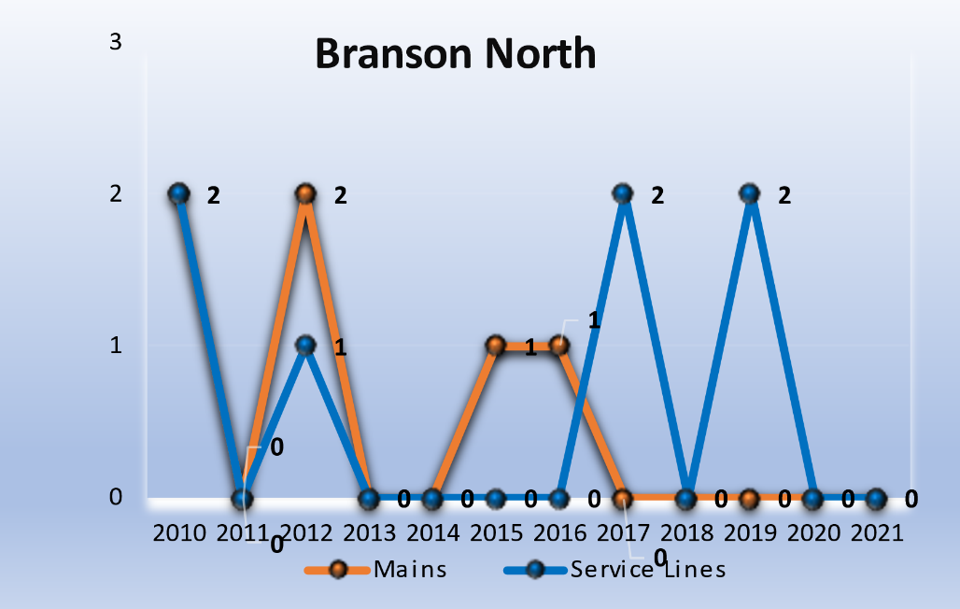
#8 – Branson North
2010 to 2021
6 Water Main Leaks/Breaks
Main Sizes: 4-inch, 12-inch
Material: Thin-walled PVC & Transite Pipe
10 Service Line Leaks
Current Length of Water Main:
2.39 Miles
Proposed Water Main Rehab Length:
1.23 Miles
Projected Cost:
Water Main: $2.0 Million
Notes:
Total Street Replacement Cost - $346,052
Storm Water Project – Unknown at this time

Slide 13
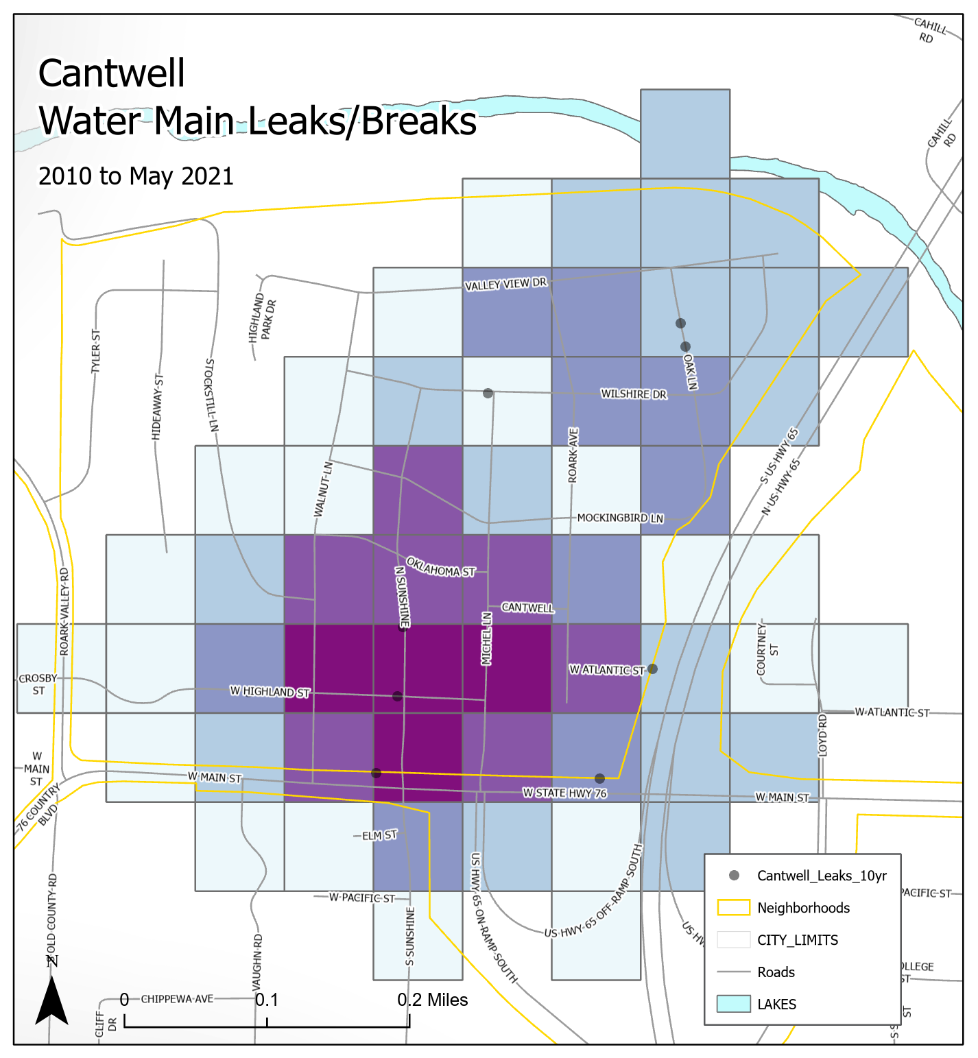
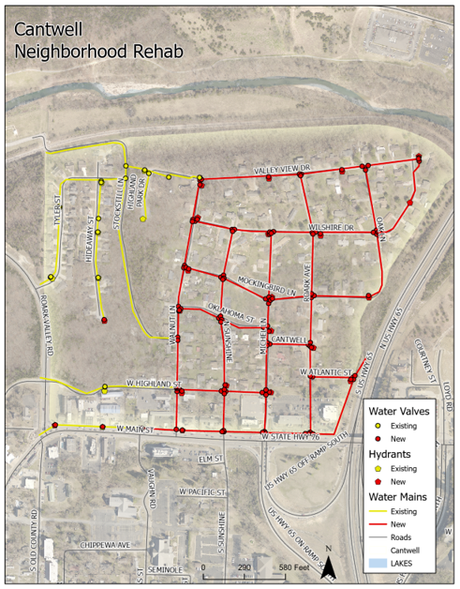
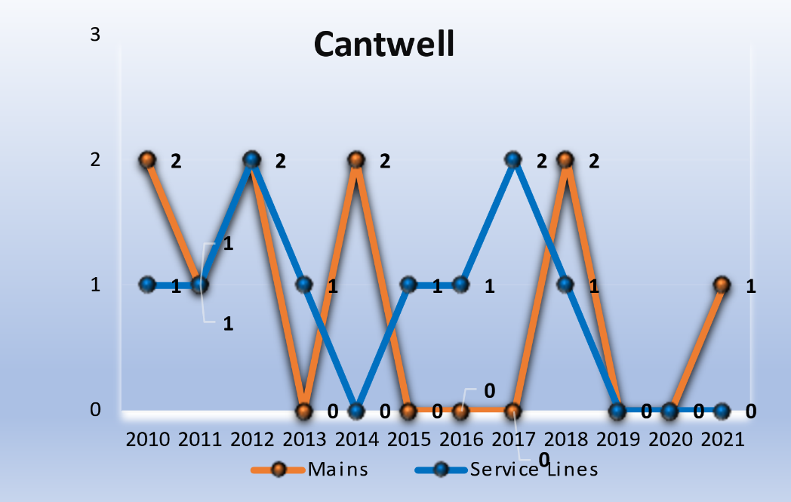
#9 – Cantwell
2010 to 2021
10 Water Main Leaks/Breaks
Main Sizes: 4-inch, 6-inch, 8-inch
Material: Thin-walled PVC & Transite Pipe
12 Service Line Leaks
Current Length of Water Main:
4.23 Miles
Proposed Water Main Rehab Length:
3.06 Miles
Projected Cost:
Water Main: $4.9 Million
Notes:
Total Street Replacement Cost - $753,786
Storm Water Project – Unknown at this time
Private Sewer Services - $177,000

Slide 14
Summary
Total Projected Cost of Waterlines for all 9 Neighborhoods: $39.6 Million*
Total Miles of Waterlines for all 9 Neighborhoods: 24.84 Miles
Total Projected Project Duration: 18-20 Years
With much of the City’s neighborhood underground infrastructure reaching its average lifespan, the likelihood of watermain leaks will continue to increase.
Investing in watermain replacement will pay off in the long run. You will see a downward trend in the number of main breaks per year, which will save in water production cost, parts, and payroll. New mains are designed to last over 100 years; updated materials and improved installation procedures will provide a more reliable service, with continued high quality of water, and plenty of water pressure. The new design will also allow the addition of additional valves to the system resulting in the ability to isolate main breaks into smaller affected areas. Additions of fire hydrants will help in the area fire protection.
*Total projected costs do not include the repair, replacement, or upgrades to city streets, curb and gutter, sidewalk or storm sewers impacted by the installation of water lines.
Notes:
Overall cost figure $300/FT of water main.
Other Items to consider:
Private sanitary sewer service lines within the public right-of-way.
Private water services must be replaced within 45 days if a public “lead” line is replaced.
Public sanitary sewer main point repairs and replacements.
Storm water improvements
Mill and Overlay priority list
All in all, it will take commitment and significant planning to coordinate a complete subdivision rehab to mitigate ongoing issues.

